Slide 1
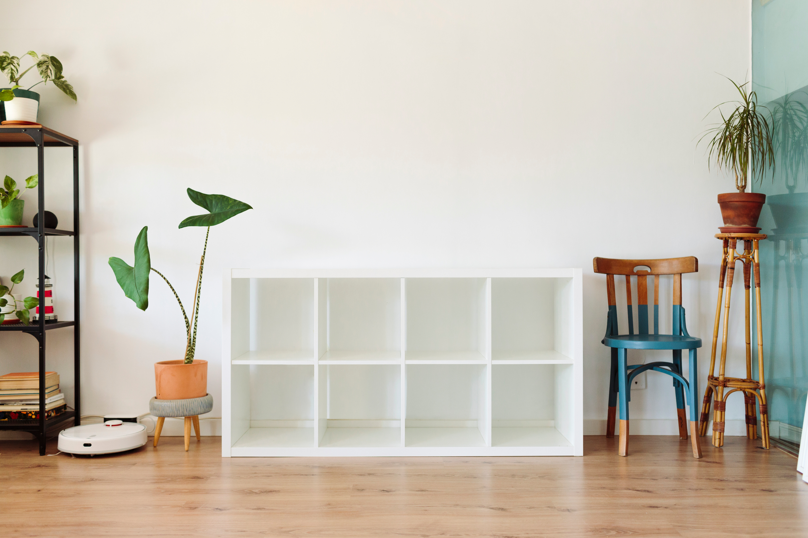


SnapShelf
Adapt Your Storage, Your Way
By
Deepshika Soni
Note: This presentation requires "presentation mode" to view all content

Slide 2

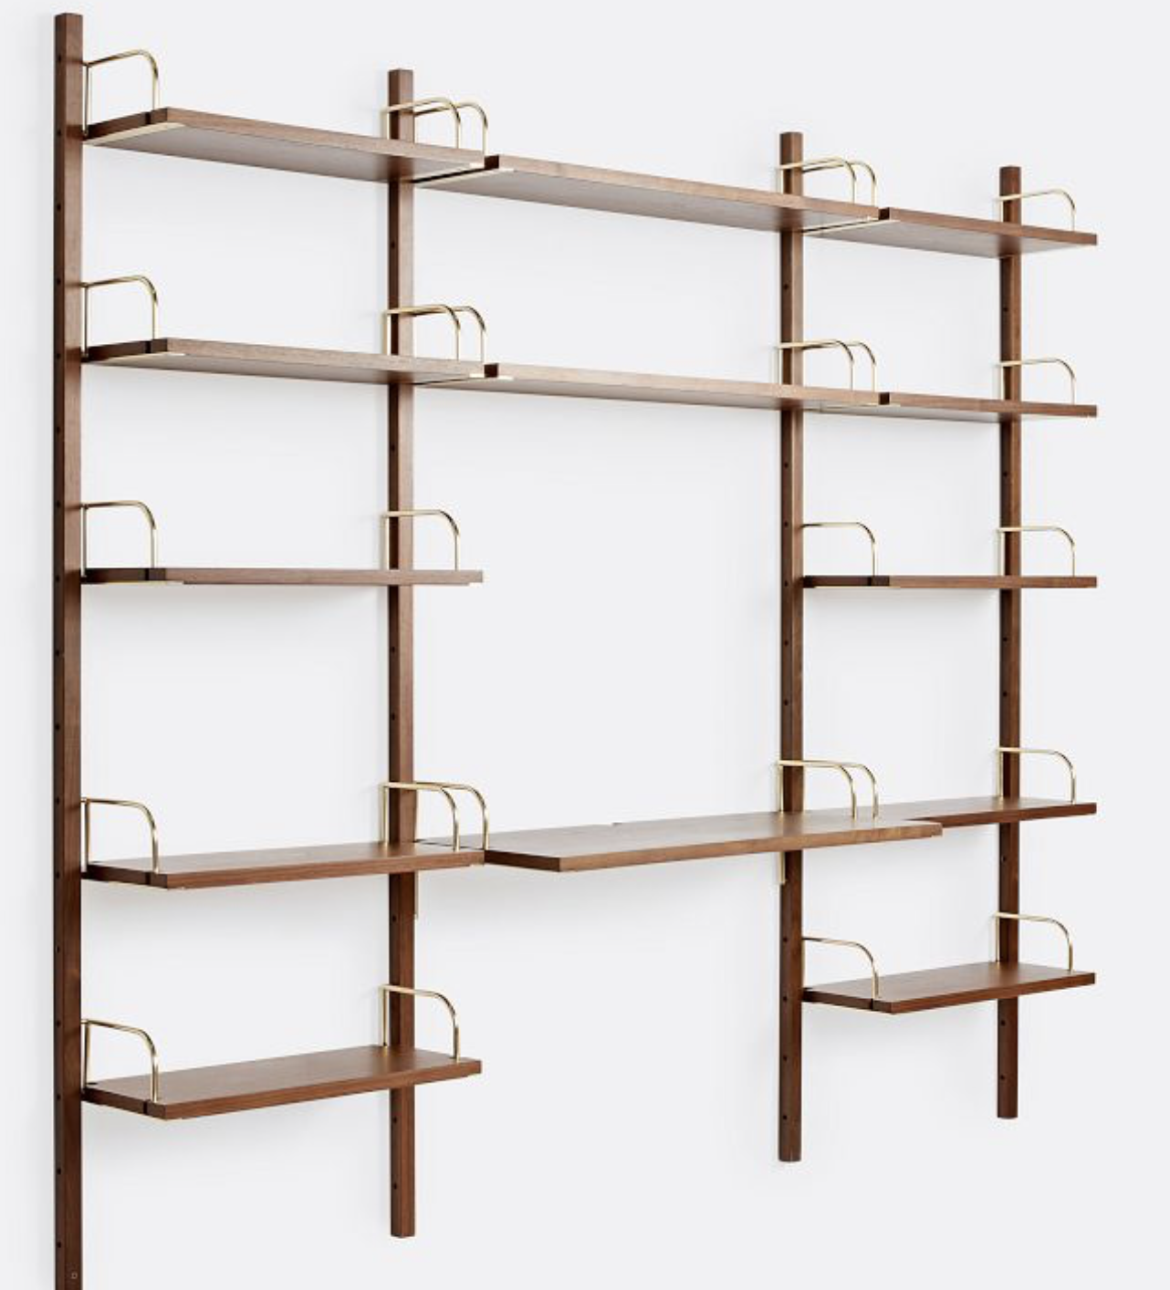
Defining the Problem & Pain Points
People want
​
Full-customizability
​Simple modular storage
Renter friendly storage
Current Storage Pain Points:
Lack of customization
New storage solution needed for each new space
Non-renter friendly storage
Adjustable
Overall size fixed
Not renter friendly

Slide 3
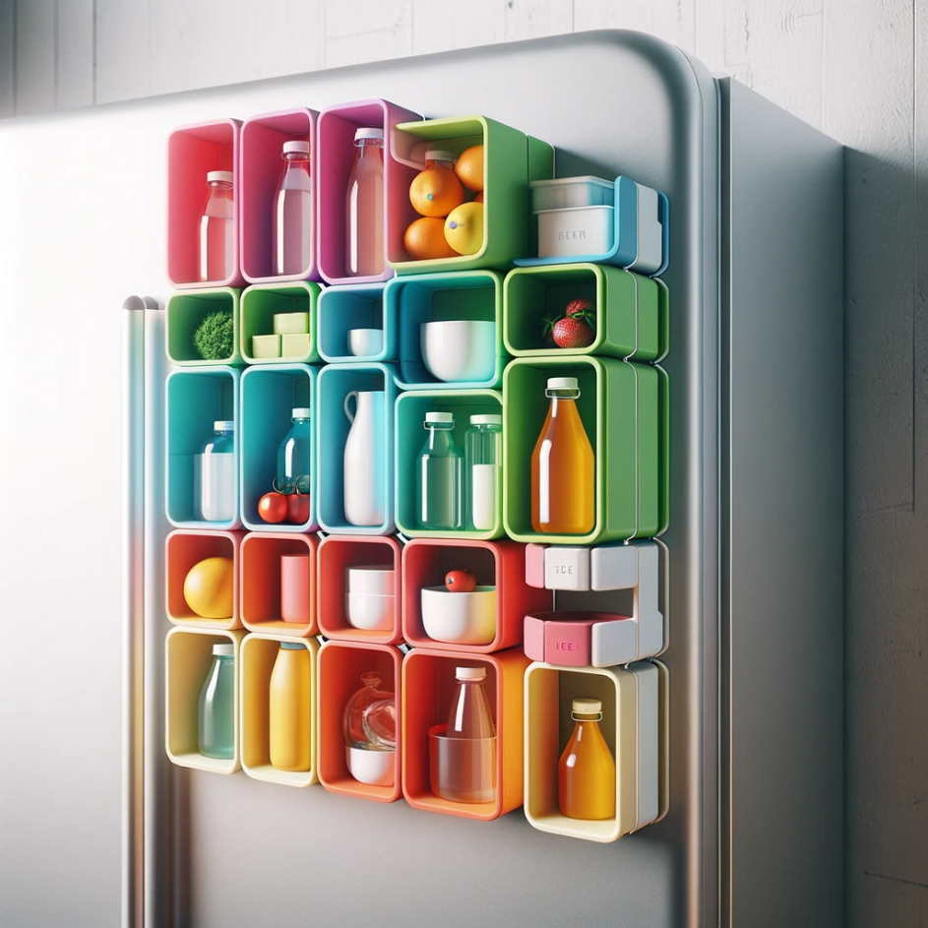
Our Product Vision
SnapShelf aims to simplify and enhance living spaces with versatile, modular storage solutions that adapt to the user’s changing needs

Slide 4

User Base & User Assumptions
(2023)
Renter Needs
38.9 million renters with average of 526 sq feet/resident (Reed, 2023)
Renter and Homeowner Needs
Over 50% of renters move within 3 years (Lester, 2023)
30.6% of people reorganize their home every few months (Joybird, 2023)
Storage Needs
37.6% of storage market is modular storage (Mordor Intelligence, 2024)
Space Efficiency
Need for space efficient storage which takes up limited floor space
Storage Adjustability
Need new storage organization for each new property
Evolving needs within home (ex. Rise in work from home spaces)
Modularity
Storage trends growing towards modular storage, especially in urban high rental areas

Slide 5
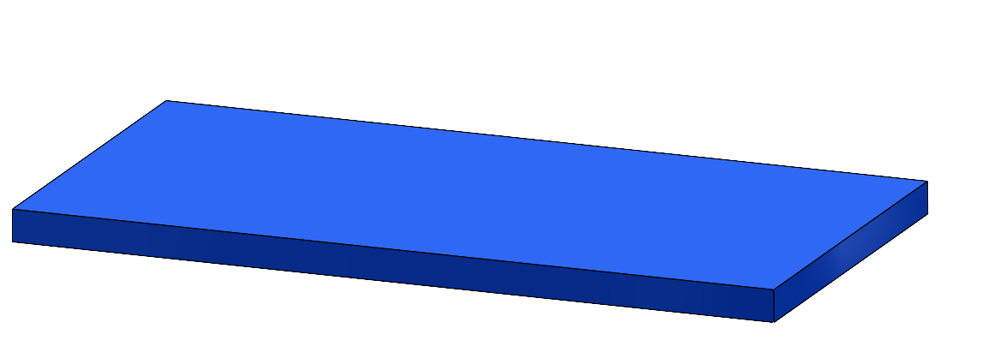
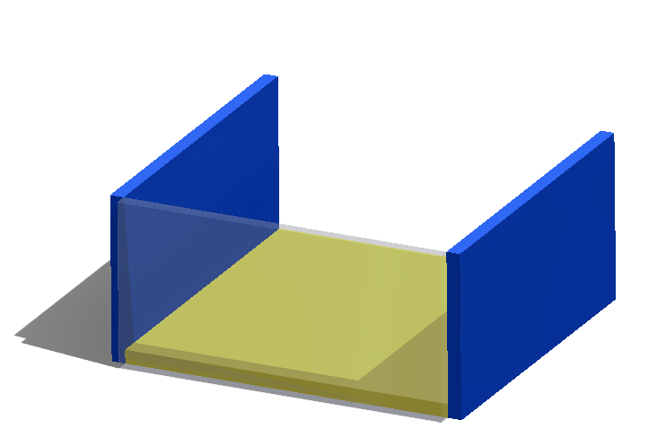
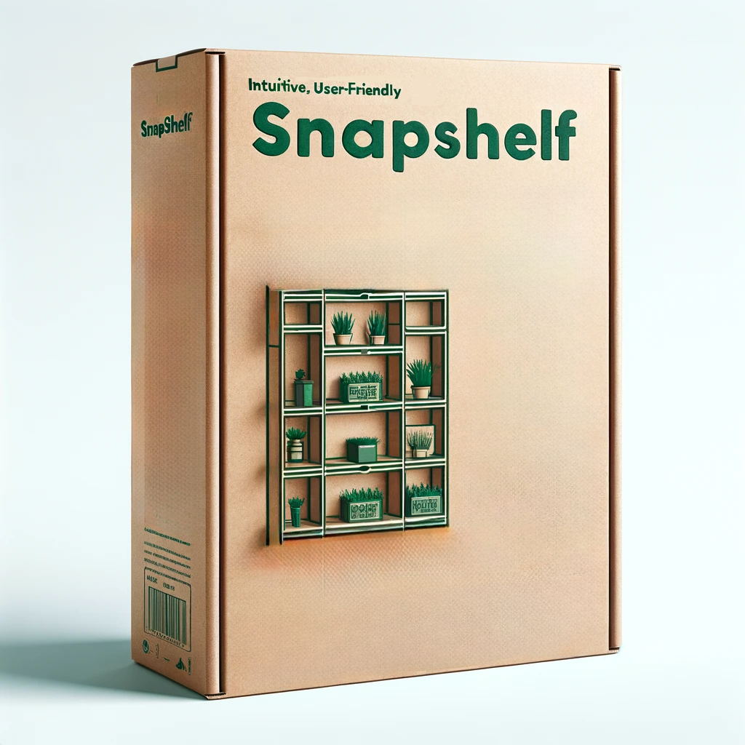

Product Concept
Components:
Plastic blocks of different sizes with magnetic strips along edges
Optional add-on stainless steel sheet
Use: Any piece can be used as a shelf OR part of a container
Benefits:
Multifunctional pieces
Quick and easy storage reconstruction

Slide 6


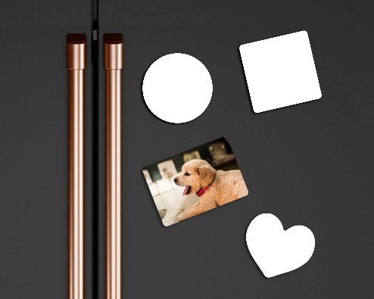
Key Features
Magnetic Connectivity: Strong magnetic strips allow the blocks to securely attach to magnetic surfaces and to each other, facilitating a range of configurations.​
Modular Design: Users can create shelves or containers of various sizes and shapes, enhancing the functionality and aesthetic appeal of their storage space.​
Durability & Maintenance: ABS material ensures the blocks are scratch-resistant, easy to clean, and durable under everyday use conditions.​
User-Friendly: Clear indicators on each piece guide the user in connecting the pieces together, allowing for intuitive assembly and reconfiguration.
​
Color drops: Different color options dropped every season, consisting of block combinations of 3 neutral colors, allowing the user to match to their interior design

Slide 7

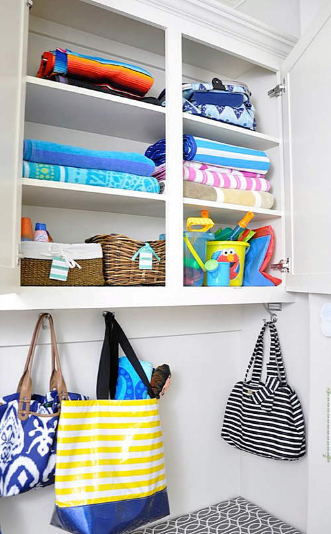

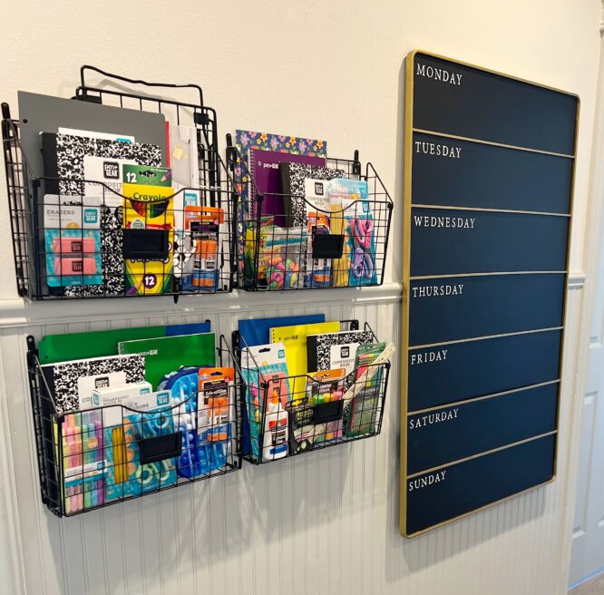
Use Cases
Paul (45 y/o)
Parent
Wants a quick and easy way to adjust his limited storage space to his children's seasonal needs
Summer mudroom
Back to school mudroom

Slide 8


Market Research
Total Addressable Market (TAM)
$3.3 Billion
Serviceable Addressable Market (SAM)
$1 Billion
Serviceable Obtainable Market (SOM)
$5 Million
Modular -> Shelf & Container ~ 30% of market
Predicted penetration rate (0.5%)

Slide 9



Differentiation & Competition
 | Multi-functional Parts | No Tools Required | Rental-Friendly | Different Configurations Possible | Different Color Palettes
SnapShelf
Perch by Honey Can Do
Magnetic Shelf by Studio3SDesign
Modular Pegboard Shelving by Container Store
Stove Shelf

Slide 10









Business Model Canvas
Cost Structure
Magnetic strips: $4.39/unit
Plastic blocks: $4.87/unit
2' x 1' stainless steel sheet: $12 (Shapiro Metal Supply
Injection molds: ($10-15k)
Labor: $1.50/unit (Formlabs)
Packaging: 10% - 40% of retail (Madhurakavi, 2023)
Cost of marketing
Customer Segments
Young apartment owners, particularly in urban areas
Homeowners, especially
with children
Desk sharing offices
Universities
Schools
Coworking companies
Value
PROPOSITIONS
Storage is modular and expandable
Storage is adjustable and fits each individual and their changing storage needs
Connects to magnetic surfaces so it does not take up counter or floor
Can be moved around and used in different areas when needed
Not permanent and does not need to be screwed into a wall, making it ideal for renters
KEY RESOURCES
Materials from suppliers
Manufacturing relationship
Human resources
Product team:
Engineers, marketing,
finance, sales, lawyers, etc.
Customer service
Social media partners
KEY PARTNERS
Manufacturers
Suppliers and wholesalers
Retailers
Hardware stores (Lowes, Home Depot)
Home Furnishing stores (HomeGoods, IKEA)
Third party online retailers
(Amazon)
Social media partners (ex.
Influencers, companies willing to run ads)
Customer segments for design verification and validation
Revenue Systems
Revenue from sales of $20 product and $18 magnetic sheet online & retail
Competitive pricing strategy
$20 sale price vs $28-45 Amazon
Seasonal sales and promotions
Seasonal limited edition drops
CHANNELS
Direct to consumer sales from website
Sales from Amazon
Sales from retail locations (ex. Hardware stores, HomeGoods)
Social media marketing linked to online store front (ex. Ads in apartment hunting groups)
Customer
Relationships
Attracting customers
Online ads
Social media promotion
Maintaining customers
2-year warranty
Expansions to current product (ex. can buy more shelf pieces
KEY ACTIVITIES
Manufacturing shelf and magnetic parts
Packaging design
Marketing
User research to validate user needs
User research to
determine ideal price
Notes:
Add “operational cost” to Cost structure
It could include tech support cost, employee salary etc

Slide 11
Market Specification
User Requirement | Definition | Rationale | Performance Expectation | Source
Sticks to magnetic surface | The product must stay securely attached to a magnetic surface when installed properly. | Essential for functionality and user safety. | Minimum: Securely holds to magnetic surface Target: Securely holds to a magnetic surface even when bumped or jostled | Market research supporting need for adjustable/temporary storage types Competitor (Perch) has containers which connect to any magnetic surface
Holds weight of typical kitchen or office materials | The product must support the weight of common kitchen and office items without bending, breaking, or removing from magnetic surface. | Ensures product usability and prevents damage to stored items. | Minimum: Holds light items (spices, utensils, pencils, erasers) without visible strain. Target: Holds heavy items (cookbooks, large utensils, notebooks, etc.) | Market research on common items needed to be stored and their weights Competitor claims the ability to store heavy items like electronics
Pieces can be connected in various configurations | The product should allow users to create shelves and containers of varied sizes and shapes to fit their needs. | Enhances versatility and user satisfaction. | Minimum/Target: The user can create multiple, distinct storage configurations from the same set of pieces | Market research of competitors like Perch who offer 12 distinct shelf and container types
Package/label communicates unique value of product | The packaging and label should clearly highlight the product's key features and benefits. | Attracts customer attention and promotes sales. | Minimum/Target: Packaging uses clear, concise language and engaging visuals to highlight the product's advantages over competitors. | Market research on target audience needs and analysis of competitor’s packaging (ex. Perch)

Slide 12
Product Specification
Comprising a set of magnetically interlocking base blocks and end caps made from ABS, this system allows users to customize storage solutions in a variety of configurations to meet their specific needs. The system is particularly suitable for environments with limited space, such as small kitchens or office areas.​
Components:​
10 Thin Base Blocks: 6" x 3" x ¼'' made from ABS material. Each block has a magnetic strip on all four sides along the ¼'' thickness.​
2 Base Blocks: 6" x 6" x ¼'', also made from ABS, with magnetic strips on all four sides and on the perimeter of the top and bottom faces.​
4 End Caps: 3" x 3" x ¼'', made from ABS, with magnetic strips on all four sides and on the perimeter of the top and bottom faces.

Slide 13
Product Specification
Category | Type Spec | Technical Requirement: Minimum | Technical Requirement: Target | Test Method | Standard / Measure | Priority
FUNCTIONAL / PERFORMANCE | Impact Resistance | No detachment at impact of 5 ft-lb | No detachment or damage at impact of 10 ft-lb | Block shear test for adhesive bonds | ASTM D950 | H | Adhesive magnets can withstand over 10 ft-lb of impact
FUNCTIONAL / PERFORMANCE | Weight Support | Single shelf piece support 5 pounds without deformation or detachment | Single shelf piece support 10 pounds without deformation or detachment | Static load test | ASTM D1143 | H | Average magnetic strip of length used in product can hold ~ 13 pounds
FUNCTIONAL / PERFORMANCE | Configuration Flexibility | 5 distinct configurations | 10+ distinct configurations | Configuration efficiency test | In-house criteria | M | 5+ configurations possible with number of shelving pieces
PACKAGING | Package Messaging | Package displays at least 2 possible configurations of storage | Package displays at least 4 possible configurations of storage | N/A | N/A | M | Used to attract customers

Slide 14
DFMEA
Item | Function | Potential Failure | Potential Effect Of Failure | Sev | Cause(s) Of Failure | Occ | Det | RPN | Recommended Actions
MAGNETIC STRIPS | Secure attachment of blocks in various configurations | Magnetic strip falls off or moves out of place | Shelf or container falls apart, resulting in Injury or broken items Pieces cannot be connected in marketed configurations | 9 | Adhesive degradation over time Exposure of adhesive to water or extreme temperatures | 4 | 3 | 108 | Select high-grade adhesive Conduct testing with adhesive under different load, temperature, and liquid exposure conditions. Instructions for customer as to how to care for their product
MAGNETIC STRIPS | Secure attachment of blocks in various configurations | Magnets cannot hold weight of product | Shelf or container falls apart, resulting in Injury or broken items Customer does not find product useful | 9 | Magnetic strength insufficient for load applied by customer Magnetic degradation over time | 8 | 4 | 288 | Conduct thorough testing on load bearing capacity of magnetics in different configurations Employ marketing and human factors team to create clear descriptions of limitations of magnetic capacity while still highlighting value of product
ABS BLOCKS | Provide customizable storage by serving as shelf piece or part of container | Cracking or deformation under load | Potential collapse, resulting in injury or damage to items | 9 | Overloading Material fatigue | 4 | 6 | 216 | Reinforce structural design, specify maximum load, create supports in block design
ADD-ON STAINLESS STEEL SHEET | Serves as magnetic surface for shelving pieces if user does not already have a magnetic surface | Adhesives connecting sheet to wall falls off | Sheet falls off wall, resulting in shelves or containers falling Risk of injury or broken items Customer does not find product useful | 9 | Adhesive degradation over time Exposure of adhesive to water or extreme temperatures | 4 | 3 | 108 | Select high-grade adhesive Conduct testing with adhesive under different load, temperature, and liquid exposure conditions Integrate findings into instructions for customer as to how to care for their product

Slide 15











Stakeholder Matrix
Category | Stakeholder | Role in Project
Investors |  | Capital injection Strategic guidance
Suppliers |  | Consistent material supply Quality assurance
Strategics |  | Product exposure Access to customers
Outsourced project services |  | Efficient completion of essential business functions (ex. Manufacturing)
Regulators |  | Ensure compliance to national and international safety standards
Venture Capitalist
Private Equity Firm
De Jesus Logistics LLC.

Slide 16





Product Roadmap
Q1 2026
Eco-Friendly Line
Launch SnapShelf units made from recycled materials, backed by a marketing campaign to emphasize sustainability efforts
Q1 2025
SnapShelf Pilot Launch
Launch SnapShelf with a pilot program targeting early adopters in urban areas, focusing on functionality feedback.
Q3 2025
Expand Product Line
Expand the SnapShelf line incorporating customer feedback with new sizes or features
Q2 2025
Color Drops & Community Engagement
Introduce the first series of quarterly limited-edition colors, inviting the community to vote on future colors/themes
Q4 2025
Retail Expansion
Partner with key retail chains for wider market presence and set up interactive displays in select stores

Slide 17
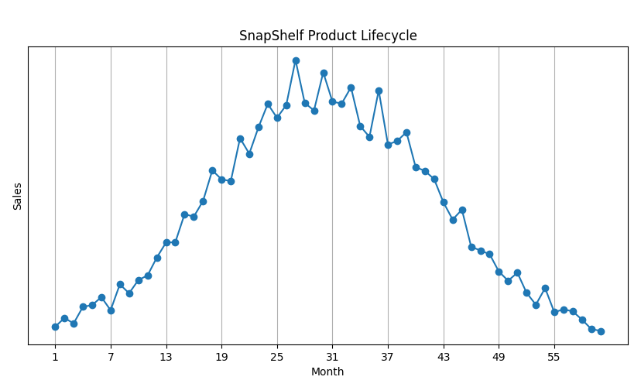
Product Lifecycle
Maturity
Growth
September Spike
Decline
Color Drop Spikes
Introduction

Slide 18
Forecasting
[2025 – 2026]
Regular Launch | Color Drop Launch
Gross Margin pcm*: Doubles [$5000 -> $10,000] | Gross Margin pcm*: Triples [$8000 -> $25,000]
September Spike: [15% -> 20%] | Color Drop Spike: [4% -> 13%]
 | Post Color Drop Down Spike: [4% -> 5%]
September Spike
Color Drop Spikes
*pcm: per calendar month

Slide 19
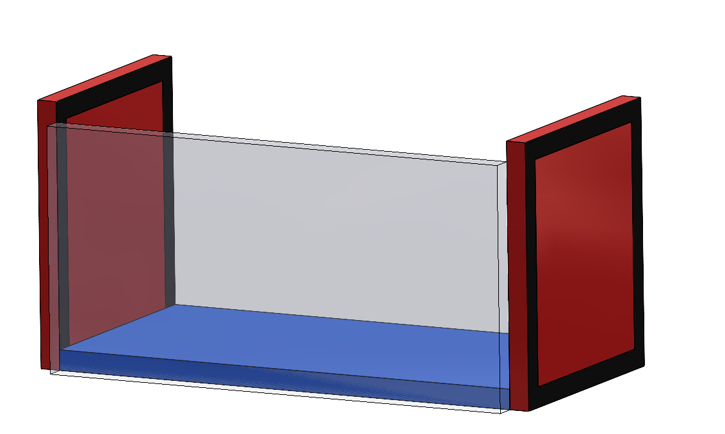
Conclusion
SnapShelf offers one-of-a-kind modular storage with multi-functional pieces, allowing for more configurations per piece than competitors
Competitive price point and versatility attracts customers with a wide variety of storage needs
Limited edition seasonal color drops encourage returning customers and cyclical product hype

Slide 20
THANK
YOU

Slide 21
References
Harvey, Anuk. “Research: How Often Do Teachers Change Their Classroom Configuration?” Natural Pod, 26 July 2019, naturalpod.com/research-how-often-do-teachers-change-their-classroom-configuration/.
“How to Estimate Injection Molding Cost?” Formlabs, formlabs.com/blog/injection-molding-cost/. Accessed 26 Mar. 2024.
Mali, Sneha. “The U.S. Home Organization Products Market Size Was USD 11.79 Billion in 2023!” Cognitive Market Research, 13 Dec. 2023, www.cognitivemarketresearch.com/home-organization-products-market-report.
Lester, Demetria. “Renters Are Three Times More Likely to Relocate than Homeowners.” theMReport.Com, 22 Aug. 2023, themreport.com/news/data/08-22-2023/renters-more-likely#:~:text=2019%20or%20later.-,Renters%20are%20more%20than%20three%20times%20as%20likely%20to%20have,average%20of%2016.76%25%20of%20homeowners.
Reed, Catherine. “24 Insightful Apartment Statistics – 2023 - Flex: Pay Rent on Your Own Schedule.” Flex, 9 Jan. 2023, getflex.com/blog/apartment-statistics/.
“Surveying Americans on Home Organization in 2023.” Joybird, Joybird, 2023, joybird.com/blog/home-organization-2023/.
“The True Cost of Custom Colorants.” Plastics Today, Plastics Today, 10 Nov. 2023, www.plasticstoday.com/materials/the-true-cost-of-custom-colorants.
“US Home Organizers and Storage Market Size & Share Analysis - Industry Research Report - Growth Trends.” US Home Organizers And Storage Market Size, Mordor Intelligence, 2024, www.mordorintelligence.com/industry-reports/united-states-home-organizers-and-storage-market.

